Slide 1
Fair Income Prediction: Mitigating Gender Bias with Fairness-Aware Machine Learning
Notes:
University of Helsinki researchers:
Mirkka Sarparanta, Academy Research Fellow, Department of Chemistry Subunit
Tracers in Molecular Imaging (TRIM)
Jose Filipe Silva, Associate professor, Department of Philosophy, History and Art Studies

Slide 2
Why Address Gender Bias in Income Prediction?
AI affects hiring, promotions, and salaries (e.g., Amazon recruitment tools).
Historical data shows men often earn more than women (Adult dataset).
Models can amplify existing inequalities if trained on biased data.
Ethical & legal risks: biased decisions may violate anti-discrimination laws.
Fairness-aware models promote equitable decisions and build trust in AI.

Slide 3
Adult / census income dataset
Task: Predict whether an individual earns > $50K per year
Number of instances: 48,842 records
Number of features: 14 attributes (numerical and categorical)
Target variable: income (binary: ≤50K or >50K)
Sensitive attribute: Gender (Male / Female)
Key features:
- Age, Workclass, Education level,
- Marital status, Occupation, Relationship,
- Race, Hours per week, Native country
Mostly clean data but contains some missing values (represented as ?)

Slide 4
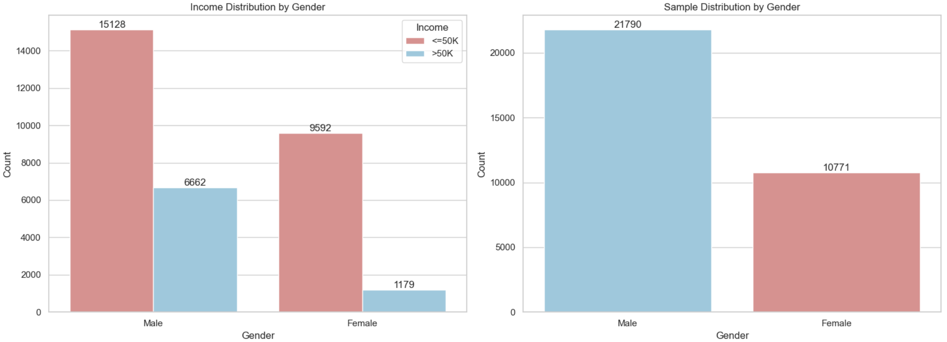
Distribution of Income and Gender in the Dataset

Slide 5
Our approach
Train baseline models (Logistic Regression and Random Forest) without constraints.
Apply Exponentiated Gradient (EG) to enforce Demographic Parity (DP) during training.
Demographic Parity (DP): aim for similar positive prediction rates for men and women.
Evaluate models on both accuracy and fairness metrics (DPD, DPR, EOD, EOR).
Compare baseline vs fairness-constrained models to understand trade-offs.

Slide 6
Exponentiated Gradient
Optimization method used to train models while enforcing fairness
Used with Demographic Parity constraints in our project
Learns several models and combines them as a weighted ensemble
(weight of model at step t is how accurate and fair it is)
(adjusts dataset weights based on how unfair the prediction was)
Adjusts model weights to reduce bias at each iteration
Final outcome = model with balanced accuracy & fairness

Slide 7
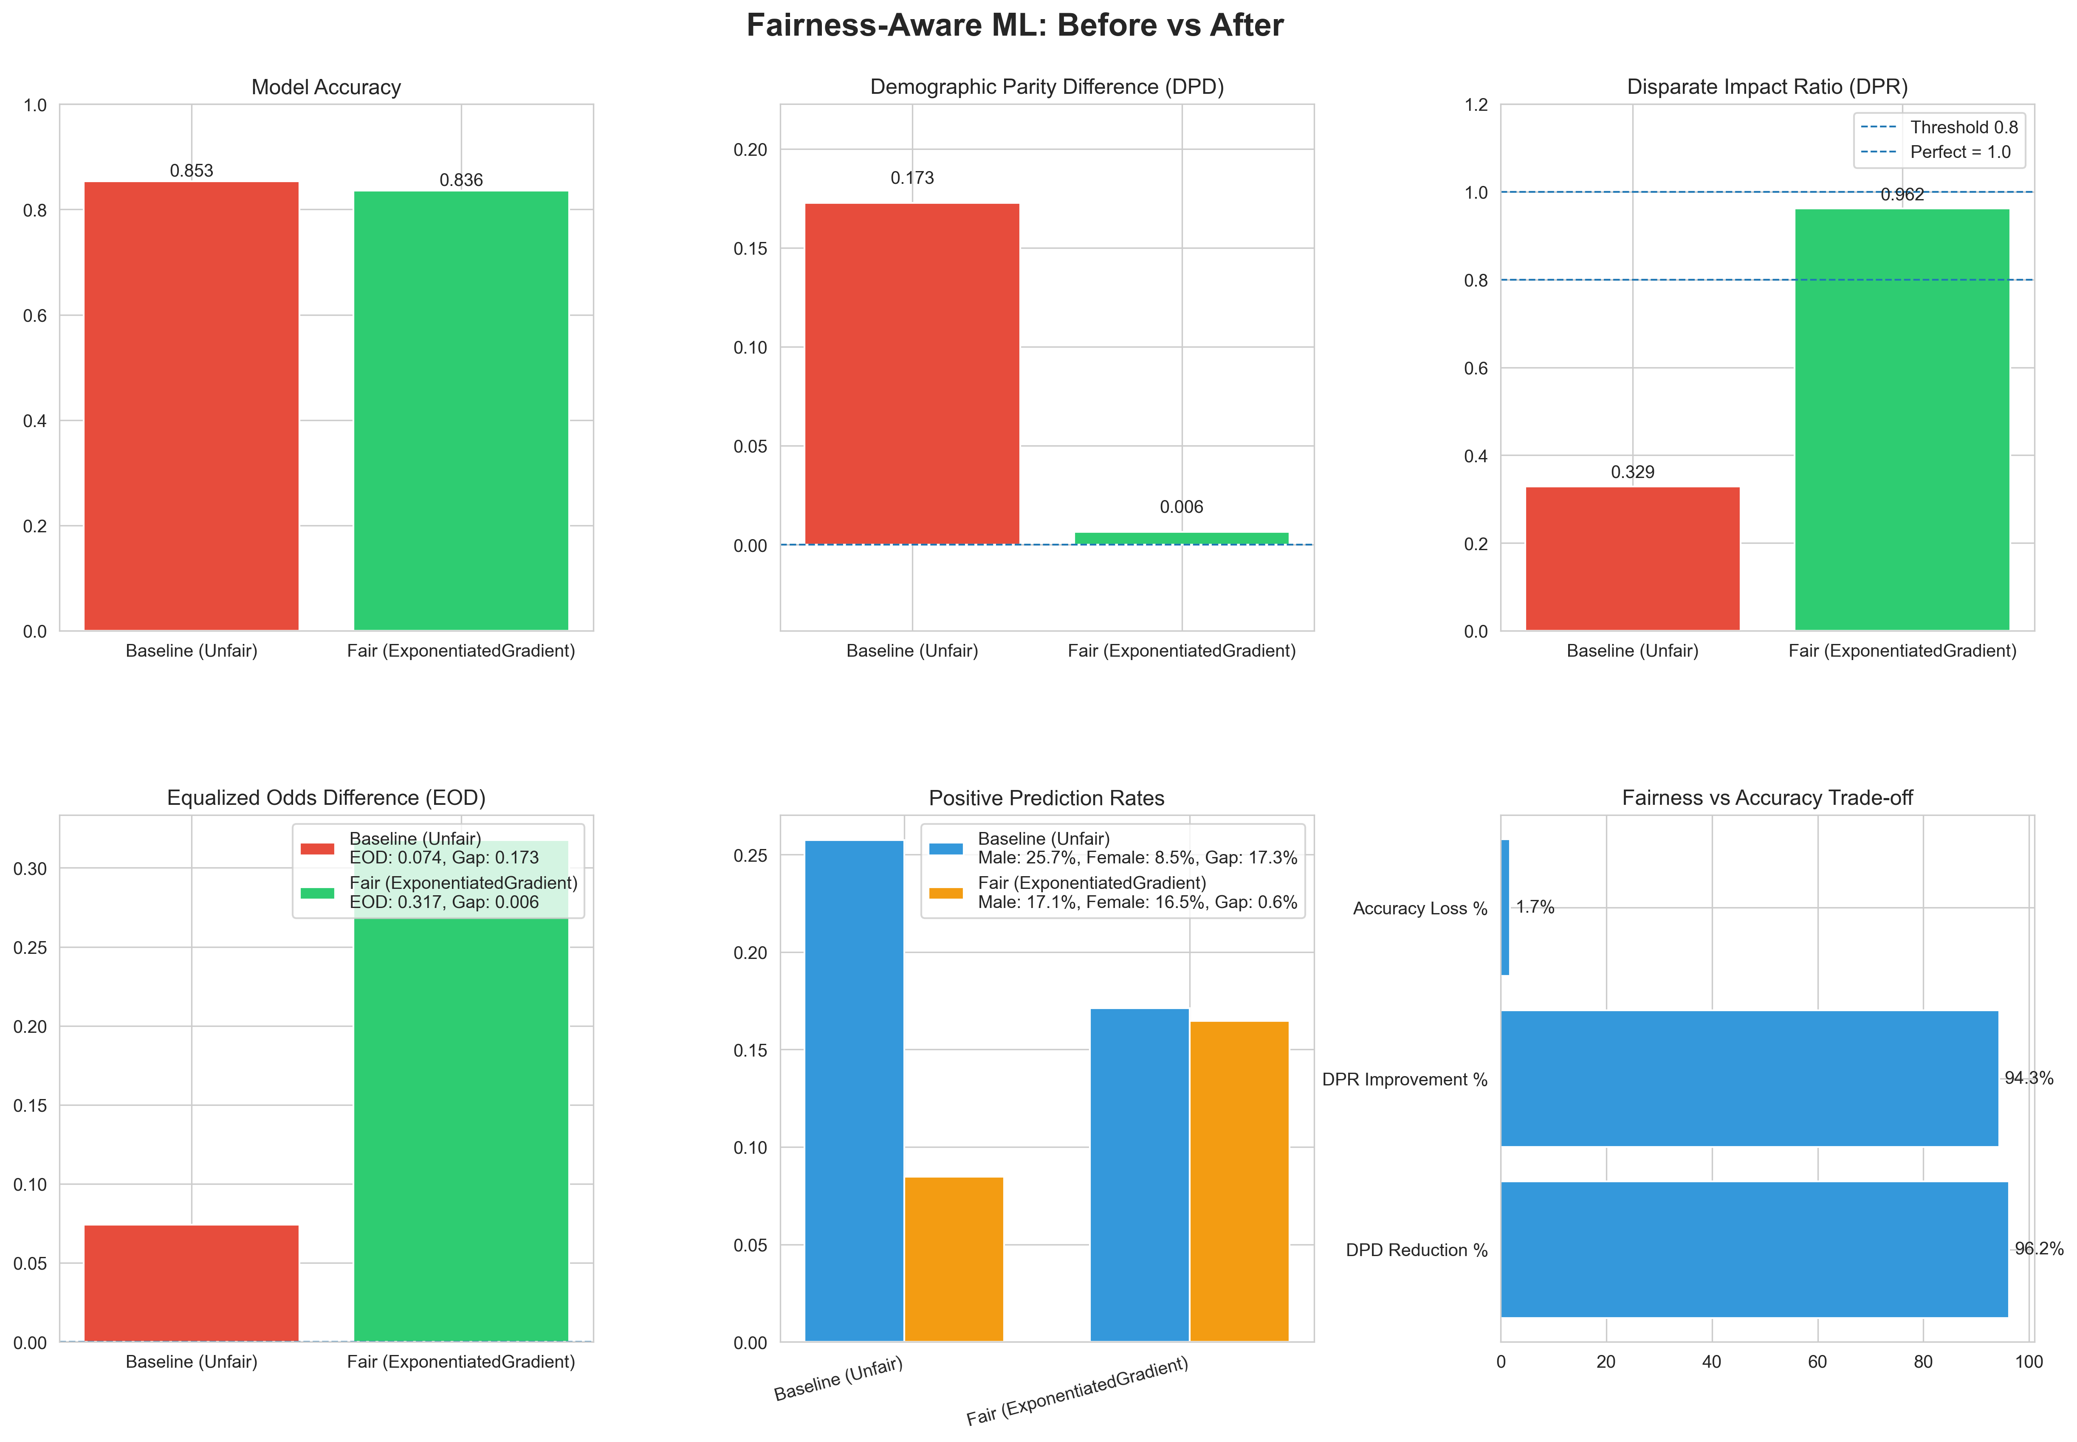
Logistic Regression

Slide 8
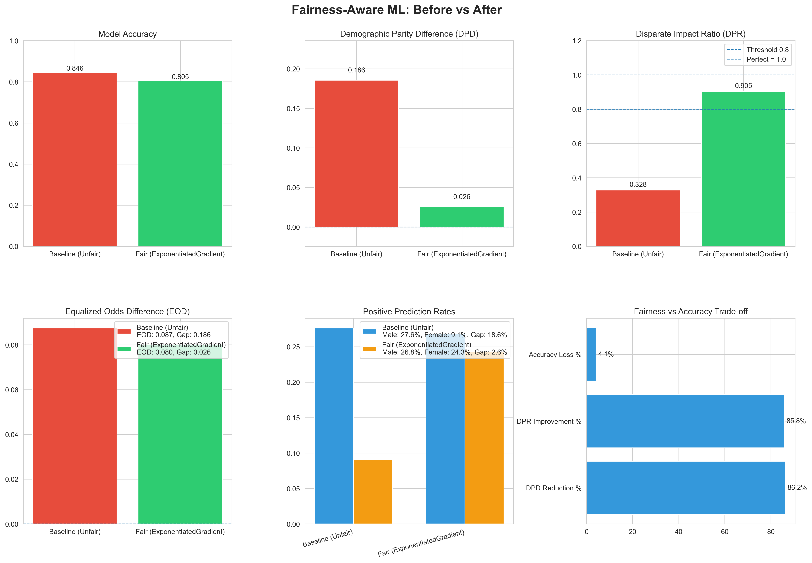
Random Forest

Slide 9
Conclusion
Baseline models (LR & RF) showed clear gender disparities in predictions
Applying Exponentiated Gradient with Demographic Parity reduced bias significantly
Fair models achieved better balance between male & female prediction rates
Some reduction in accuracy occurred — but fairness improved meaningfully
Demonstrates that mitigating bias is achievable without destroying performance
Fairness-aware methods make ML systems more ethical, trustworthy and deployable

Slide 10
Thank you
Any questions?

